Slide 1

InternXpert – Smart Internship Explorer and Verification Portal
by
T. DEVI SREE
Roll No. 224G1A0516
V. SAI GANESH REDDY
Roll No. 224G1A0589
S. NANDAVARDHAN REDDY
Roll No. 224G1A0556
Under the guidance of
Mr. K. LOKESHNATH, M.Tech (Ph.D.)
Assistant Professor
Department of Computer Science and Engineering
Srinivasa Ramanujan Institute of Technology
Autonomous
Rotarypuram Village, B K Samudram Mandal, Ananthapuramu – 515701.
2025-2026

Slide 2

Contents
Title Justification
Abstract
Problem statement
Objectives of Project
Literature survey for objectives
Proposed Work -(Methods to be followed for proposed system)
References
GitHub Link
Queries

Slide 3
Title Justification
Project Title:
InternXpert – Smart Internship Explorer and Verification Portal
Title Justification:
1. InternXpert: Represents a smart expert-like system that guides students in choosing the right internships. Combines “Intern” and “Expert” to highlight intelligent, student-focused support.
2. Smart: Indicates that the platform uses intelligent features such as filtering, recommendations, and verification. Shows that the system is modern, automated, and efficient for users.
3. Internship Explorer: Highlights the platform’s role in helping students search, filter, and discover suitable internships. Ensures users can easily browse opportunities based on skills, domain, and preferences.
4. Verification Portal: Emphasizes the core feature of checking internship authenticity for student safety .Ensures trust by identifying fake, misleading, or unreliable internship listings.

Slide 4
Abstract
The rapid growth of online internship platforms has resulted in a large number of fake and misleading internship postings. This makes it difficult for students to identify genuine, safe, and trustworthy internship opportunities.
Most existing platforms do not have strong mechanisms to verify the authenticity of internship providers. They also offer generic recommendations without considering individual student skills, interests, and preferences.
To overcome these limitations, InternXpert: Smart Internship Explorer and Verification Portal is developed to ensure verified internships and reliable employer information for students.
The system verifies company details using online verification techniques and analyzes internship postings to reduce fraudulent listings. It also provides intelligent recommendations using smart filtering based on skills, domain interests, and preferences.
InternXpert enhances the overall internship search experience by improving matching accuracy and platform reliability. The solution reduces exposure to fake internships and provides a safer, smarter, and more informed internship exploration environment.

Slide 5
Problem Statement
Students increasingly face fake and misleading internship postings, leading to exploitation and loss of trust.
There is no reliable verification mechanism in existing platforms to ensure internship authenticity.
Students struggles to find internships that match their skills, domain, and preferences due to poor filtering.
There is a need for a centralized and intelligent system that provides verified internships, smart filtering, and safe exploration.

Slide 6
Objectives of Project
Research Objective 1:
To develop a smart system that verifies the authenticity of internship listings, ensuring safe and reliable opportunities for students.
Research Objective 2:
To design an intelligent internship exploration mechanism that filters and recommends opportunities based on students skills, domain preferences, and requirements.

Slide 7
Literature survey for objectives
1. Internship Authenticity Verification Models
Amaar et al. (Neural Processing Letters, 2022) proposed a machine learning and NLP-based approach to detect fake job postings using techniques such as TF-IDF, Bag-of-Words, and supervised classifiers. The model achieved high accuracy in identifying fraudulent job advertisements and helped improve trust in online recruitment platforms. However, the study focused only on detection and did not integrate internship recommendation or user-specific filtering mechanisms.
2. Skill-Based Recommendation Frameworks
Ghosh et al. (IEEE International Conference on Big Data, 2020) presented a skill-based career path modeling and recommendation framework that analyzed user skills and mapped them to suitable career opportunities. The approach improved the relevance of recommendations through intelligent skill modeling. However, the system did not consider the authenticity verification of job or internship providers, limiting its ability to ensure safe internship exploration.

Slide 8
Proposed System
The proposed system InternXpert provides a secure platform that verifies internship authenticity by checking company information and source credibility.
A smart internship explorer allows students to search and filter opportunities based on domain, skills, stipend, work mode, and preferences.
A recommendation module suggests suitable internships according to user profiles and selected filters to improve search relevance.
An optional chatbot assistant guides users by capturing their requirements and helping them navigate the system more easily.
A simple and user-friendly interface enables students to browse verified internships, receive accurate results, and stay updated through optional notifications.

Slide 9
References
[1] A. Amaar, W. Aljedaani, F. Rustam et al., “Detection of Fake Job Postings Using Machine Learning and Natural Language Processing,” Neural Processing Letters, Springer, vol. 54, pp. 2219–2247, 2022.Focuses on detecting fake job/internship postings using ML and NLP techniques to ensure authenticity.
[2] A.Ghosh, B. Woolf, S. Zilberstein, and A. Lan, “Skill-Based Career Path Modeling and Recommendation, ”IEEE International Conference on Big Data, 2020.Proposes skill-based modeling and intelligent recommendation mechanisms for career opportunities.
[3] A.S. Pillai, “Detecting Fake Job Postings Using Bidirectional LSTM,” arXiv preprint, arXiv:2304.02019, 2023. Uses deep learning (BiLSTM) for automated detection of fraudulent job postings.

Slide 10
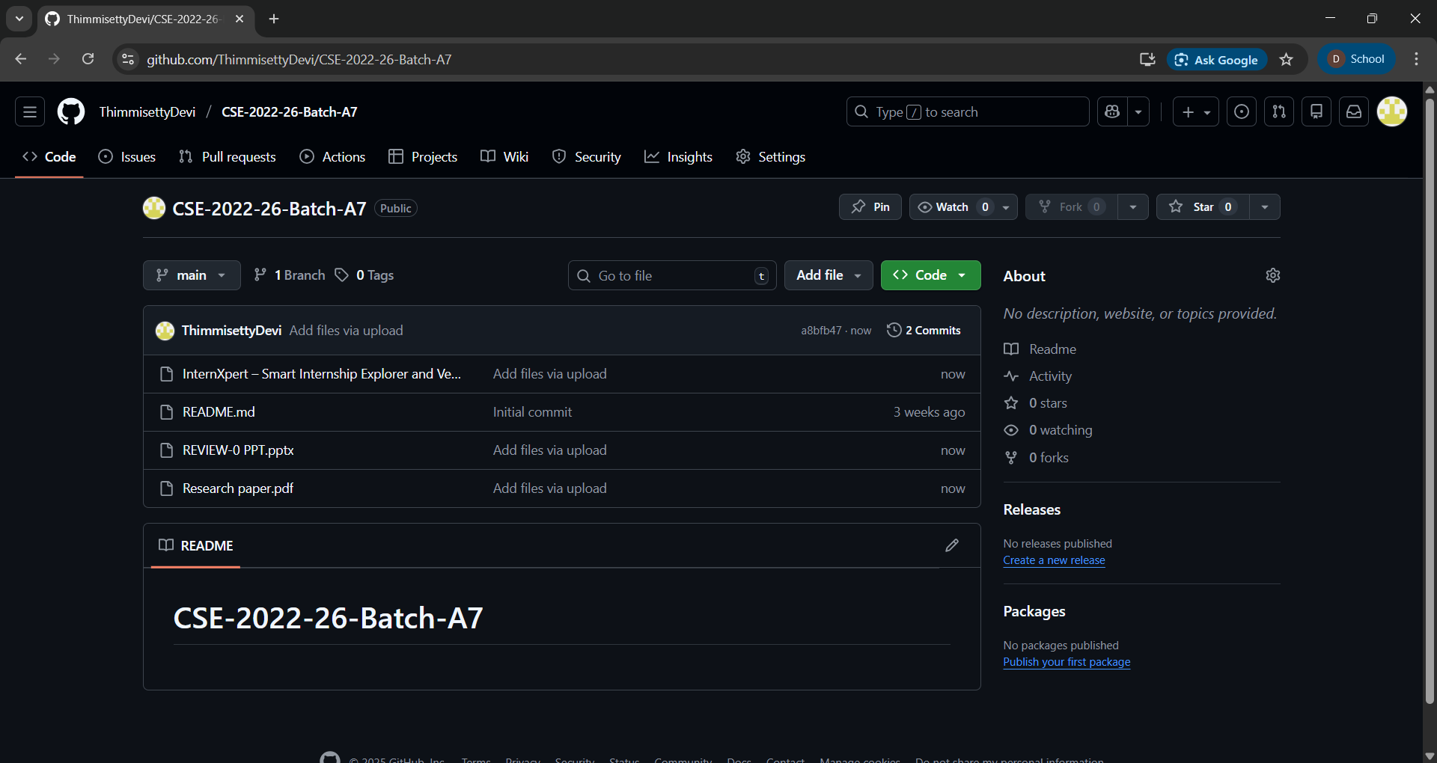
Git Hub Dashboards of each student
Link of the GitHub: https://github.com/ThimmisettyDevi/CSE-2022-26-Batch-A7

Slide 11
Any Queries?

